Slide 1
Random Number Generation
Desirable Attributes:
  Uniformity
  Independence
  Efficiency
  Replicability
  Long Cycle Length
Random Numbers
Notes:
30

Slide 2
Random Number Generation (cont.)
Each random number R_{t} is an independent sample drawn from a continuous uniform distribution between 0 and 1
⎧1 , 0 ≤ x ≤ 1
pdf: f(x) = ⎨
⎩0 , otherwise
Random Numbers
Notes:
30

Slide 3
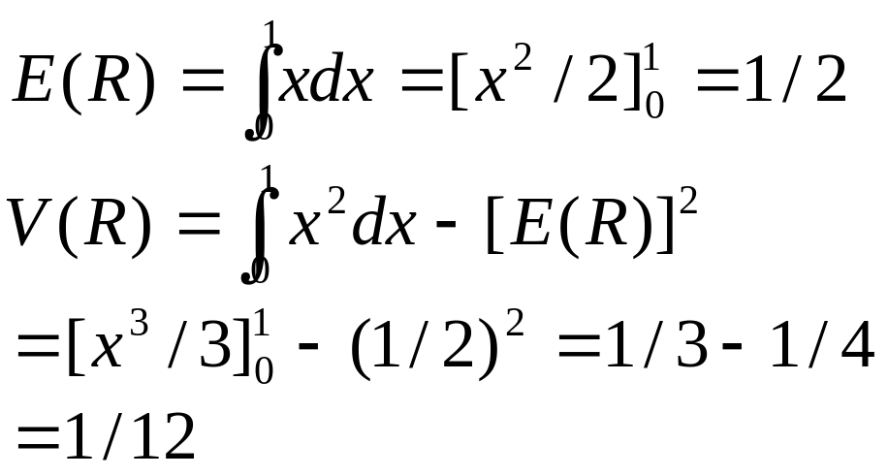
Random Number Generation
(cont.)
1
PDF:
f(x)
0
x
Random Numbers
Notes:
30

Slide 4
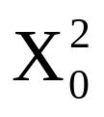
Techniques for Generating Random Number
MidSquare
  Example:
  X₀ = 7182 (seed)
  = 51581124
  ==> R₁ = 0.5811
  = (5811) ² = 33767721
  ==> R₂ = 0.7677
  etc.
Random Numbers
Notes:
30

Slide 5
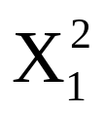
Techniques for Generating Random Number (cont.)
Note: Cannot choose a seed that guarantees that the sequence will not degenerate and will have a long period. Also, zeros, once they appear, are carried in subsequent numbers.
Ex1: X₀ = 5197 (seed) = 27008809
  ==> R₁ = 0.0088 = 00007744
  ==> R₂ = 0.0077
Ex2: X₀ = 4500 (seed) = 20250000
  ==> R₁ = 0.2500 = 06250000
  ==> R₂ = 0.2500
Random Numbers
Notes:
30

Slide 6
Techniques for Generating Random Number (cont.)
Multiplicative Congruential Method:
  Basic Relationship
  X_{i+1} = a X_{i} (mod m), where a ≥ 0 and m ≥ 0
  Most natural choice for m is one that equals to the capacity of a computer word.
  m = 2^{b} (binary machine), where b is the number of bits in the computer word.
  m = 10^{d} (decimal machine), where d is the number of digits in the computer word.
Random Numbers
Notes:
30

Slide 7
Techniques for Generating Random Number (cont.)
The max period(P) is:
  For m a power of 2, say m = 2^{b}, and c ≠ 0, the longest possible period is P = m = 2^{b} , which is achieved provided that c is relatively prime to m (that is, the greatest common factor of c and m is 1), and a = 1 + 4k, where k is an integer.
  For m a power of 2, say m = 2^{b}, and c = 0, the longest possible period is P = m / 4 = 2^{b-2} , which is achieved provided that the seed X₀ is odd and the multiplier, a, is given by a = 3 + 8k or a = 5 + 8k, for some k = 0, 1,...
Random Numbers
Notes:
30

Slide 8
Techniques for Generating Random Number (cont.)
  For m a prime number and c = 0, the longest possible period is P = m - 1, which is achieved provided that the multiplier, a, has the property that the smallest integer k such that a^{k} - 1 is divisible by m is k = m - 1,
Random Numbers
Notes:
30

Slide 9
Techniques for Generating Random Number (cont.)
(Example)
Using the multiplicative congruential method, find the period of the generator for a = 13, m = 2⁶, and X₀ = 1, 2, 3, and 4. The solution is given in next slide. When the seed is 1 and 3, the sequence has period 16. However, a period of length eight is achieved when the seed is 2 and a period of length four occurs when the seed is 4.
Random Numbers
Notes:
30

Slide 10
Techniques for Generating Random Number (cont.)
Period Determination Using Various seeds
i X_{i} X_{i} X_{i} X_{i}
0 1 2 3 4
1 13 26 39 52
2 41 18 59 36
3 21 42 63 20
4 17 34 51 4
5 29 58 23
6 57 50 43
7 37 10 47
8 33 2 35
9 45 7
10 9 27
11 53 31
12 49 19
13 61 55
14 25 11
15 5 15
16 1 3
Random Numbers
Notes:
30

Slide 11
Techniques for Generating Random Number (cont.)
SUBROUTINE RAN(IX, IY, RN)
IY = IX * 1220703125
IF (IY) 3,4,4
3: IY = IY + 214783647 + 1
4: RN = IY
RN = RN * 0.4656613E-9
IX = IY
RETURN
END
Random Numbers
Notes:
30

Slide 12
Techniques for Generating Random Number (cont.)
Linear Congruential Method:
  X_{i+1} = (aX_{i} + c) mod m, i = 0, 1, 2....
  (Example)
  let X₀ = 27, a = 17, c = 43, and m = 100, then
  X₁ = (17*27 + 43) mod 100 = 2
  R₁ = 2 / 100 = 0.02
  X₂ = (17*2 + 43) mod 100 = 77
  R₂ = 77 / 100 = 0.77
  .........
Random Numbers
Notes:
30

Slide 13
Test for Random Numbers
1. Frequency test. Uses the Kolmogorov-Smirnov or the chi-square test to compare the distribution of the set of numbers generated to a uniform distribution.
2. Runs test. Tests the runs up and down or the runs above and below the mean by comparing the actual values to expected values. The statistic for comparison is the chi-square.
3. Autocorrelation test. Tests the correlation between numbers and compares the sample correlation to the expected correlation of zero.
Random Numbers
Notes:
30

Slide 14
Test for Random Numbers (cont.)
4. Gap test. Counts the number of digits that appear between repetitions of a particular digit and then uses the Kolmogorov-Smirnov test to compare with the expected number of gaps.
5. Poker test. Treats numbers grouped together as a poker hand. Then the hands obtained are compared to what is expected using the chi-square test.
Random Numbers
Notes:
30

Slide 15
Test for Random Numbers (cont.)
In testing for uniformity, the hypotheses are as follows:
H₀: R_{i} ~ U[0,1]
H₁: R_{i} ≠ U[0,1]
The null hypothesis, H₀, reads that the numbers are distributed uniformly on the interval [0,1].
Random Numbers
Notes:
30

Slide 16
Test for Random Numbers (cont.)
In testing for independence, the hypotheses are as follows;
H₀: R_{i} ~ independently
H₁: R_{i} ≠ independently
This null hypothesis, H₀, reads that the numbers are independent. Failure to reject the null hypothesis means that no evidence of dependence has been detected on the basis of this test. This does not imply that further testing of the generator for independence is unnecessary.
Random Numbers
Notes:
30

Slide 17
Test for Random Numbers (cont.)
Level of significance α
α = P(reject H₀ | H₀ true)
Frequently, α is set to 0.01 or 0.05
(Hypothesis)
Actually True Actually False
Accept 1 - α  β
 (Type II error)
Reject α 1 - β
(Type I error)
Random Numbers
Notes:
30

Slide 18
Test for Random Numbers (cont.)
The Gap Test measures the number of digits between successive occurrences of the same digit.
(Example) length of gaps associated with the digit 3.
4, 1, 3, 5, 1, 7, 2, 8, 2, 0, 7, 9, 1, 3, 5, 2, 7, 9, 4, 1, 6, 3
3, 9, 6, 3, 4, 8, 2, 3, 1, 9, 4, 4, 6, 8, 4, 1, 3, 8, 9, 5, 5, 7
3, 9, 5, 9, 8, 5, 3, 2, 2, 3, 7, 4, 7, 0, 3, 6, 3, 5, 9, 9, 5, 5
5, 0, 4, 6, 8, 0, 4, 7, 0, 3, 3, 0, 9, 5, 7, 9, 5, 1, 6, 6, 3, 8
8, 8, 9, 2, 9, 1, 8, 5, 4, 4, 5, 0, 2, 3, 9, 7, 1, 2, 0, 3, 6, 3
Note: eighteen 3’s in list
==> 17 gaps, the first gap is of length 10
Random Numbers
Notes:
30

Slide 19
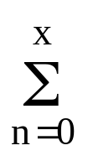
Test for Random Numbers (cont.)
We are interested in the frequency of gaps.
P(gap of 10) = P(not 3) ⋅⋅⋅ P(not 3) P(3) , note: there are 10 terms of the type P(not 3)
= (0.9)¹⁰ (0.1)
The theoretical frequency distribution for randomly ordered digit is given by
F(x) = 0.1 (0.9)^{n} = 1 - 0.9^{x+1}
Note: observed frequencies for all digits are compared to the theoretical frequency using the Kolmogorov-Smirnov test.
Random Numbers
Notes:
30

Slide 20
Test for Random Numbers (cont.)
(Example)
Based on the frequency with which gaps occur, analyze the 110 digits above to test whether they are independent. Use α= 0.05. The number of gaps is given by the number of digits minus 10, or 100. The number of gaps associated with the various digits are as follows:
Digit 0 1 2 3 4 5 6 7 8 9
# of Gaps 7 8 8 17 10 13 7 8 9 13
Random Numbers
Notes:
30

Slide 21
Test for Random Numbers (cont.)
Gap Test Example
Relative Cum. Relative
Gap Length Frequency Frequency Frequency F(x) |F(x) - S_{N}(x)|
0-3 35 0.35 0.35 0.3439 0.0061
4-7 22 0.22 0.57 0.5695 0.0005
8-11 17 0.17 0.74 0.7176 0.0224
12-15 9 0.09 0.83 0.8147 0.0153
16-19 5 0.05 0.88 0.8784 0.0016
20-23 6 0.06 0.94 0.9202 0.0198
24-27 3 0.03 0.97 0.9497 0.0223
28-31 0 0.00 0.97 0.9657 0.0043
32-35 0 0.00 0.97 0.9775 0.0075
36-39 2 0.02 0.99 0.9852 0.0043
40-43 0 0.00 0.99 0.9903 0.0003
44-47 1 0.01 1.00 0.9936 0.0064
Random Numbers
Notes:
30

Slide 22
Test for Random Numbers (cont.)
The critical value of D is given by
D_{0.05} = 1.36 / √100 = 0.136
Since D = max |F(x) - S_{N}(x)| = 0.0224 is less than D_{0.05}, do not reject the hypothesis of independence on the basis of this test.
Random Numbers
Notes:
30

Slide 23
Test for Random Numbers (cont.)
Run Tests (Up and Down)
  Consider the 40 numbers; both the Kolmogorov-Smirnov and Chi-square would indicate that the numbers are uniformly distributed. But, not so.
  0.08 0.09 0.23 0.29 0.42 0.55 0.58 0.72 0.89 0.91
  0.11 0.16 0.18 0.31 0.41 0.53 0.71 0.73 0.74 0.84
  0.02 0.09 0.30 0.32 0.45 0.47 0.69 0.74 0.91 0.95
  0.12 0.13 0.29 0.36 0.38 0.54 0.68 0.86 0.88 0.91
Random Numbers
Notes:
30

Slide 24
Test for Random Numbers (cont.)
  Now, rearrange and there is less reason to doubt independence.
  0.41 0.68 0.89 0.84 0.74 0.91 0.55 0.71 0.36 0.30
  0.09 0.72 0.86 0.08 0.54 0.02 0.11 0.29 0.16 0.18
  0.88 0.91 0.95 0.69 0.09 0.38 0.23 0.32 0.91 0.53
  0.31 0.42 0.73 0.12 0.74 0.45 0.13 0.47 0.58 0.29
Random Numbers
Notes:
30

Slide 25
Test for Random Numbers (cont.)
  Concerns:
    Number of runs
    Length of runs
  Note: If N is the number of numbers in a sequence, the maximum number of runs is N-1, and the minimum number of runs is one.
  If “a” is the total number of runs in a sequence, the mean and variance of “a” is given by
Random Numbers
Notes:
30

Slide 26
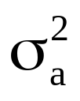
Test for Random Numbers (cont.)
  μ_{a} = (2n - 1) / 3
  = (16N - 29) / 90
  For N > 20, the distribution of “a” approximated by a normal distribution, N(μ_{a} , ).
  This approximation can be used to test the independence of numbers from a generator.
  Z₀ = (a - μ_{a}) / σ_{a}
Random Numbers
Notes:
30

Slide 27
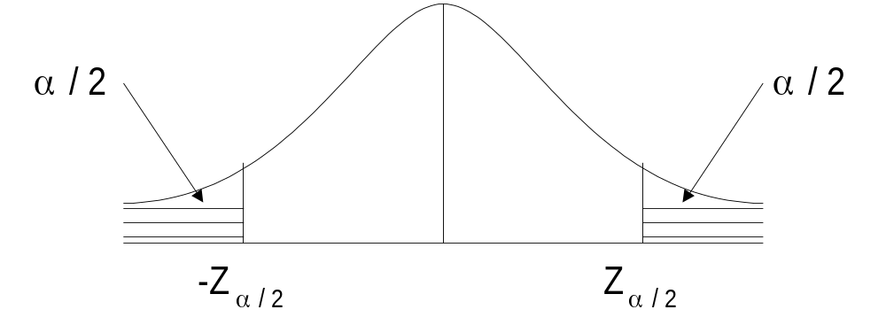
Test for Random Numbers (cont.)
  Substituting for μ_{a} and σ_{a} ==>
  Z_{a} = {a - [(2N-1)/3]} / {√(16N-29)/90},
  where Z ~ N(0,1)
  Acceptance region for hypothesis of independence -Z_{α/2} ≤ Z₀ ≤ Z_{α/2}
Random Numbers
Notes:
30

Slide 28
Test for Random Numbers (cont.)
  Concerns:
    Number of runs
    Length of runs
  Note: If N is the number of numbers in a sequence, if n1 is no of occurrences above the mean and n2 be no of occurrences below the mean.
  If “b” is the total number of runs in a sequence, the mean and variance of “b” is given by
Random Numbers
Notes:
30

Slide 29
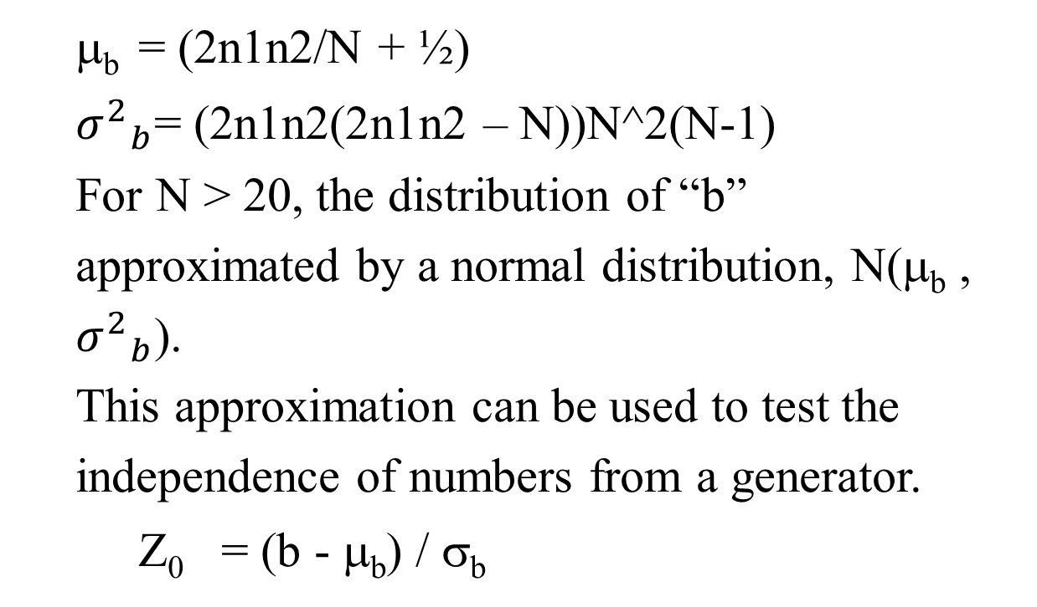
Test for Random Numbers (cont.)
Random Numbers
Notes:
30

Slide 30
Test for Random Numbers (cont.)
  Substituting for μ_{b} and σ_{b} ==>
  Z₀ = {a - [(2N-1)/3]} / {√(16N-29)/90},
  where Z ~ N(0,1)
  Acceptance region for hypothesis of independence -Z_{α/2} ≤ Z₀ ≤ Z_{α/2}
Random Numbers
Notes:
30

Slide 31
Test for Random Numbers (cont.)
(Example)
Based on runs up and runs down, determine whether the following sequence of 40 numbers is such that the hypothesis of independence can be rejected where α = 0.05.
0.41 0.68 0.89 0.94 0.74 0.91 0.55 0.62 0.36 0.27
0.19 0.72 0.75 0.08 0.54 0.02 0.01 0.36 0.16 0.28
0.18 0.01 0.95 0.69 0.18 0.47 0.23 0.32 0.82 0.53
0.31 0.42 0.73 0.04 0.83 0.45 0.13 0.57 0.63 0.29
Random Numbers
Notes:
30

Slide 32
Test for Random Numbers (cont.)
The sequence of runs up and down is as follows:
+ + + − + − + − − − + + − + − − + − + − − + − − + − + + − − + + − + − − + + −
There are 26 runs in this sequence. With N=40 and a=26,
μ_{a}= {2(40) - 1} / 3 = 26.33 and
= {16(40) - 29} / 90 = 6.79
Then,
Z₀ = (26 - 26.33) / √(6.79) = −0.13
  Now, the critical value is Z_{0.025} = 1.96, so the independence of the numbers cannot be rejected on the basis of this test.
Random Numbers
Notes:
30

Slide 33
Test for Random Numbers (cont.)
(Example)
Based on runs above and below the mean, determine whether the following sequence of 40 numbers is such that the hypothesis of independence can be rejected where α = 0.05.
0.41 0.68 0.89 0.94 0.74 0.91 0.55 0.62 0.36 0.27
0.19 0.72 0.75 0.08 0.54 0.02 0.01 0.36 0.16 0.28
0.18 0.01 0.95 0.69 0.18 0.47 0.23 0.32 0.82 0.53
0.31 0.42 0.73 0.04 0.83 0.45 0.13 0.57 0.63 0.29
Random Numbers
Notes:
30

Slide 34
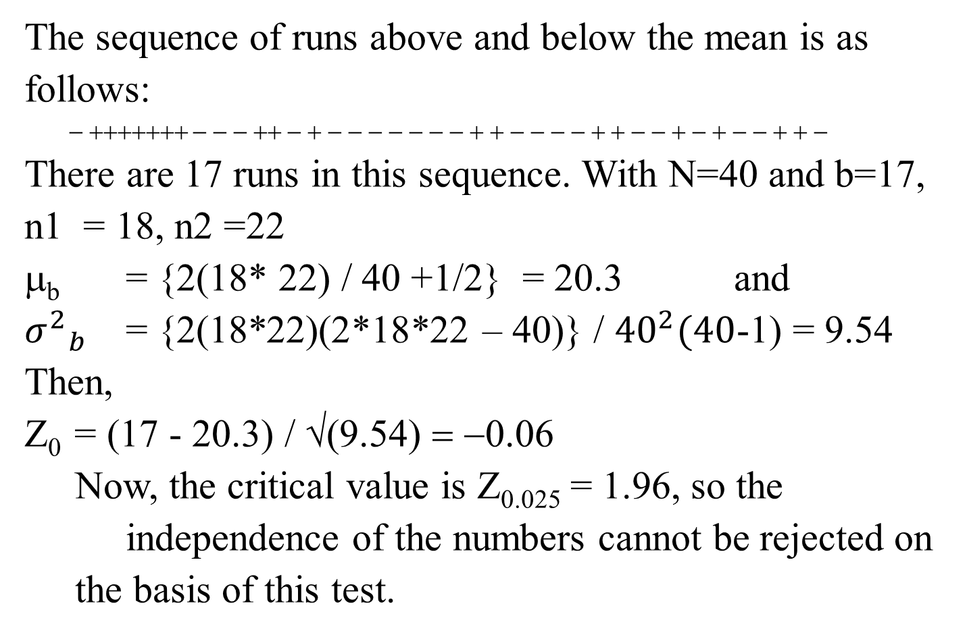
Test for Random Numbers (cont.)
Random Numbers
Notes:
30

Slide 35
Test for Random Numbers (cont.)
Poker Test - based on the frequency with which certain digits are repeated.
  Example:
  0.255 0.577 0.331 0.414 0.828 0.909
  Note: a pair of like digits appear in each number generated.
Random Numbers
Notes:
30

Slide 36
Test for Random Numbers (cont.)
  In 3-digit numbers, there are only 3 possibilities.
  P(3 different digits) =
  (2nd diff. from 1st) * P(3rd diff. from 1st & 2nd)
  = (0.9) (0.8) = 0.72
  P(3 like digits) =
  (2nd digit same as 1st) ∗ P(3rd digit same as 1st)
  = (0.1) (0.1) = 0.01
  P(exactly one pair) = 1 - 0.72 - 0.01 = 0.27
Random Numbers
Notes:
30

Slide 37
Test for Random Numbers (cont.)
(Example)
A sequence of 1000 three-digit numbers has been generated and an analysis indicates that 680 have three different digits, 289 contain exactly one pair of like digits, and 31 contain three like digits. Based on the poker test, are these numbers independent?
Let α = 0.05.
The test is summarized in next table.
Random Numbers
Notes:
30

Slide 38
Test for Random Numbers (cont.)
Observed Expected (O_{i} - E_{i})²
Combination, Frequency, Frequency, -----------
i O_{i} E_{i} E_{i}
Three different digits 680 720 2.24
Three like digits 31 10 44.10
Exactly one pair 289 270 1.33
------ ------ -------
1000 1000 47.65
  The appropriate degrees of freedom are one less than the number of class intervals. Since χ²_{0.05, 2} = 5.99 < 47.65, the independence of the numbers is rejected on the basis of this test.
Random Numbers
Notes:
30

